Slide 1

Predict Used Car prices-Regressions
DSC495(010)-Harper Wang

Slide 2
Introduction
I am trying to compare 1. Decision Tree Regression, 2. Multiple Linear Regression, and 3. Random Forest Regression prediction model and select the most accurate model to predict used car prices in the Indian market.

Slide 3
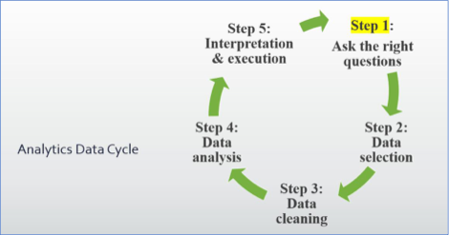

Slide 4
Cars.csv
Description for dataset
1. S.No.: Serial Number 2. Name: Name of the car which includes Brand name and Model name 3. Location: The location in which the car is being sold or is available for purchase Cities<b 4. Year: Manufacturing year of the car 5. Kilometers_driven: The total kilometers driven in the car by the previous owner(s) in KM. 6. Fuel_Type: The type of fuel used by the car. (Petrol, Diesel, Electric, CNG, LPG) 7. Transmission: The type of transmission used by the car. (Automatic / Manual) 8. Owner: Type of ownership 9. Mileage: The standard mileage offered by the car company in kmpl or km/kg 10. Engine: The displacement volume of the engine in CC. 11. Power: The maximum power of the engine in bhp. 12. Seats: The number of seats in the car. 13. New_Price: The price of a new car of the same model is INR Lakhs. (1 Lakh = 100, 000) 14. Price: The price of the used car is INR Lakhs (1 Lakh = 100, 000)

Slide 5
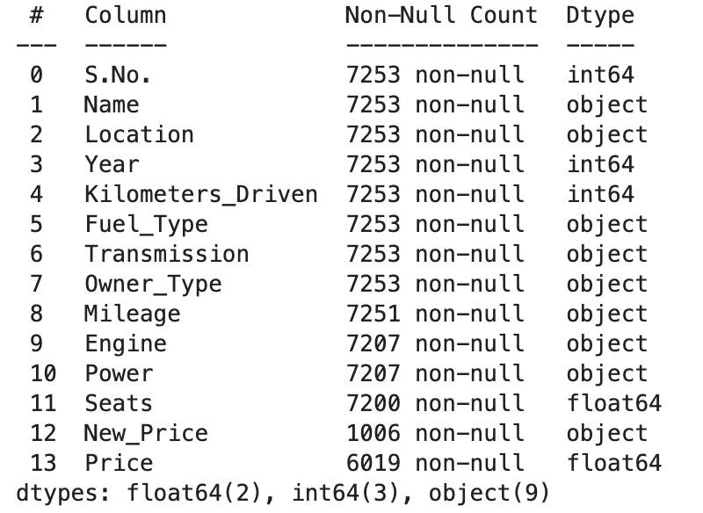
Questions:
- Does various predicting factors affect the price of the used car .? - What all independent variables affect the pricing of used cars? - How does the type of Transmission affect pricing? - Does the Location in which the car is being sold has any effect on the price? - Does kilometers Driven; Year of manufacturing have a negative correlation with the price of the car? - Does Mileage, Engine, and Power have any effect on the pricing of the car?
Start cleansing and exploring (Exploratory Data Analysis (EDA)) in Python.
Therefore, we know that "Name", "Location", "Year", "Fuel_Type",
“Transmission”, “Owner_Type”, “Seats” are categorical variables.

Slide 6
Data Cleansing
For “Mileage”, “Engine”, and “Power”, we do have units after each number, so it is better for us to remove the units to get an accurate prediction.
Drop the “New_Price”, “S.No.”, and “Name” columns because 1. the missing value will affect our regressions, and 2. we do not need name and order numbers.
Change the category variables to Binary variables in order to fit them in the regression model.

Slide 7
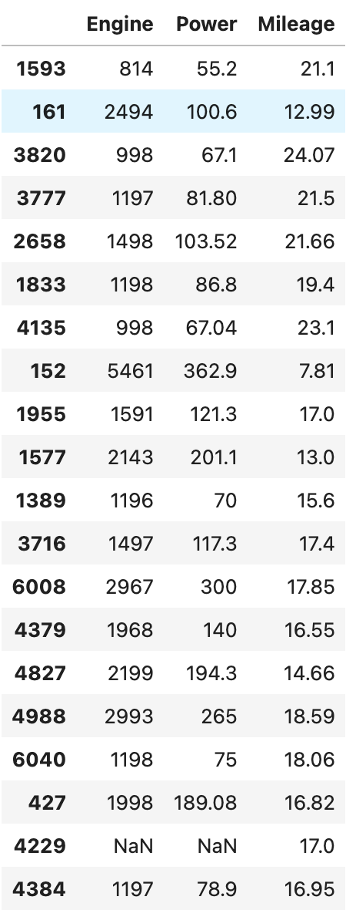
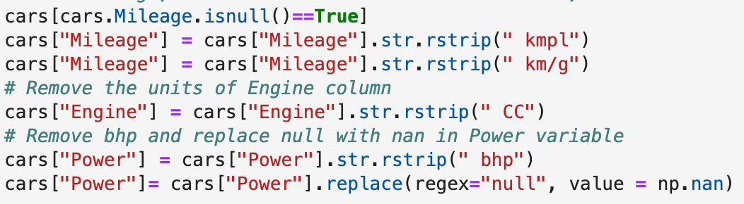
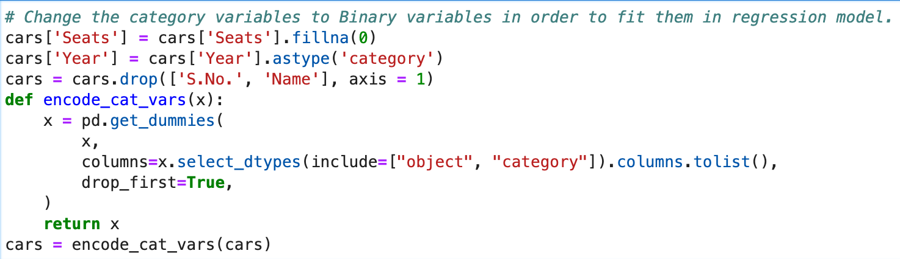
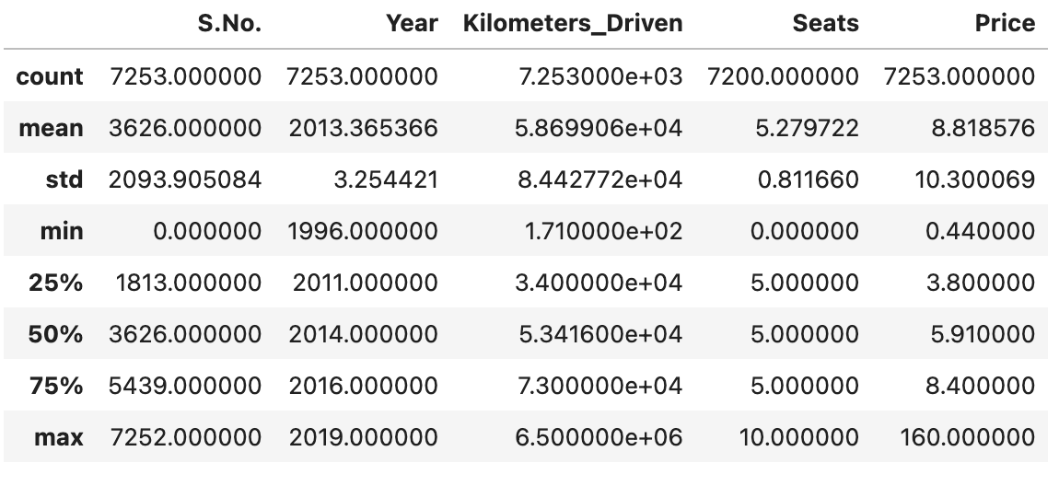
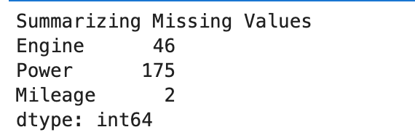

Slide 8
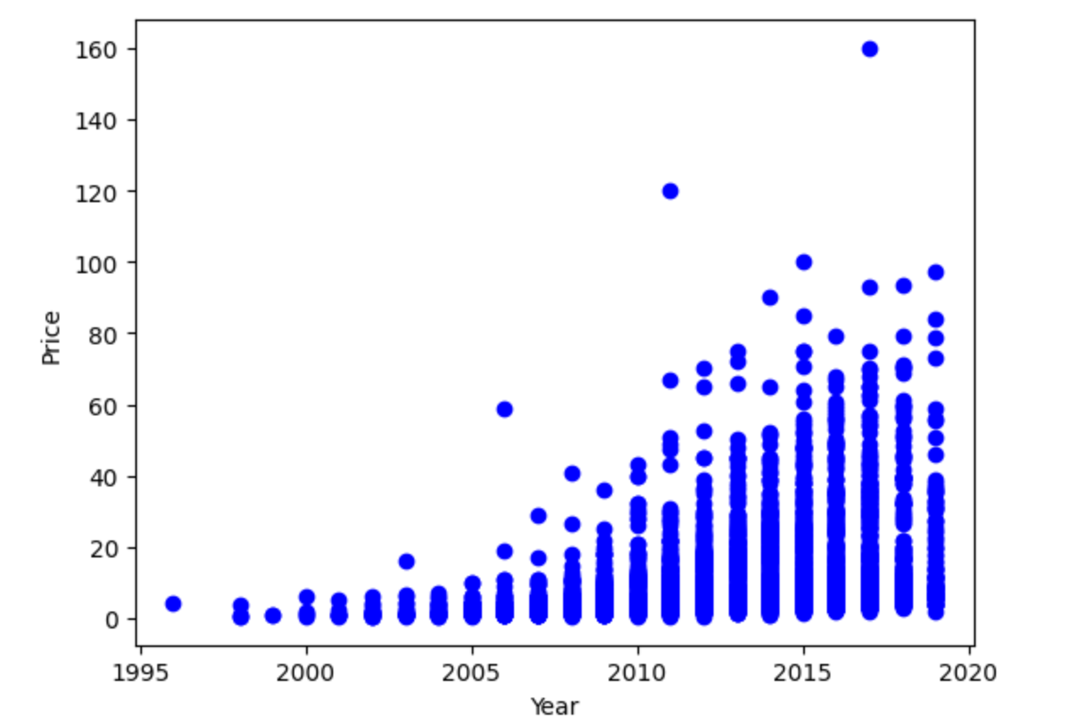
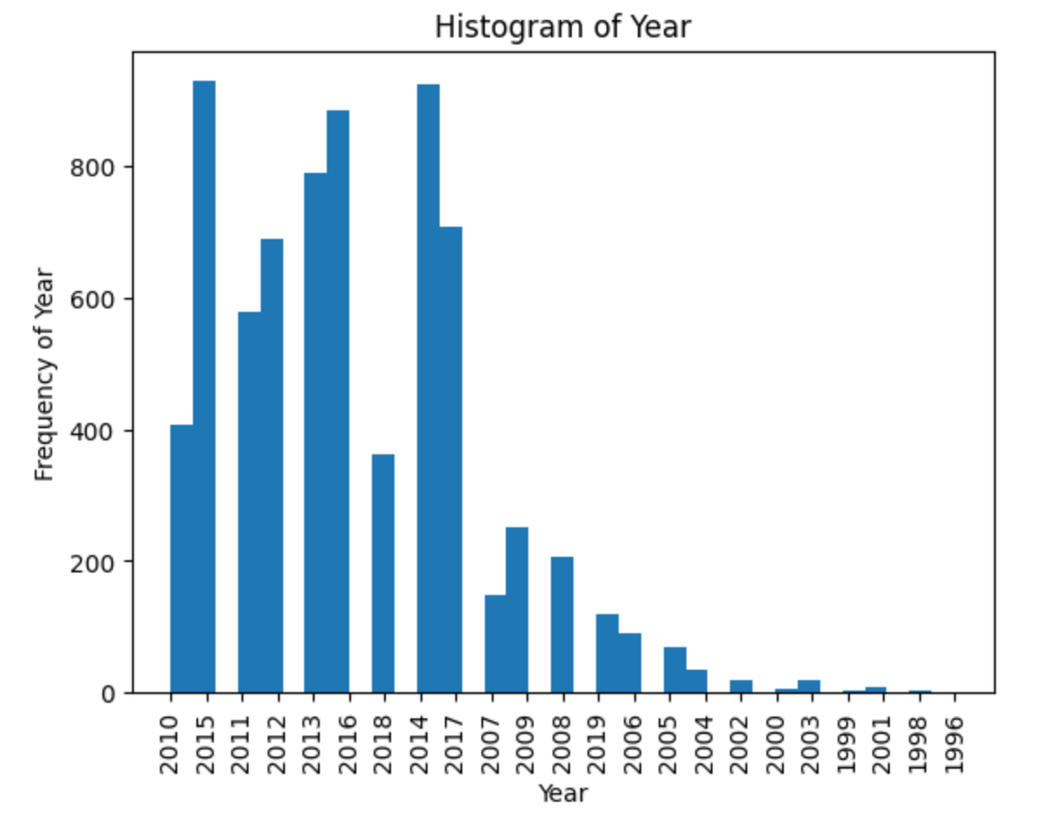
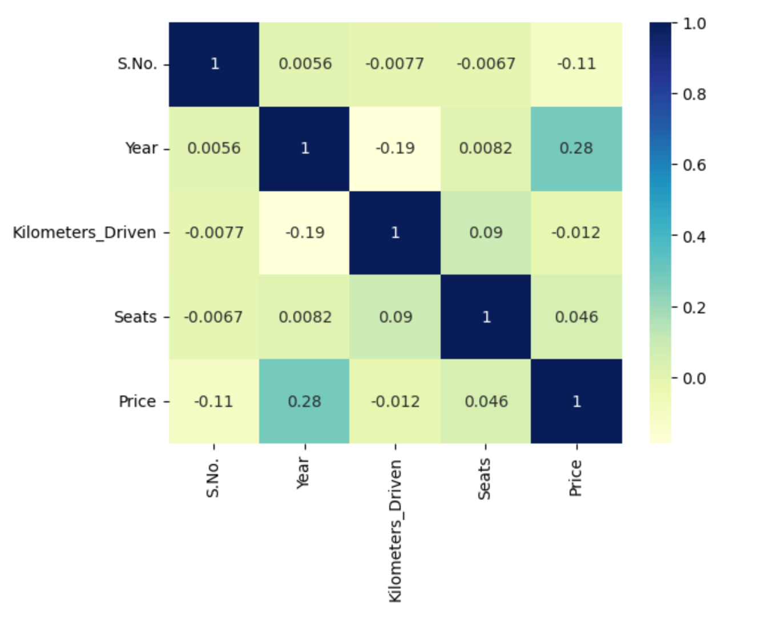
Data Visualization

Slide 9
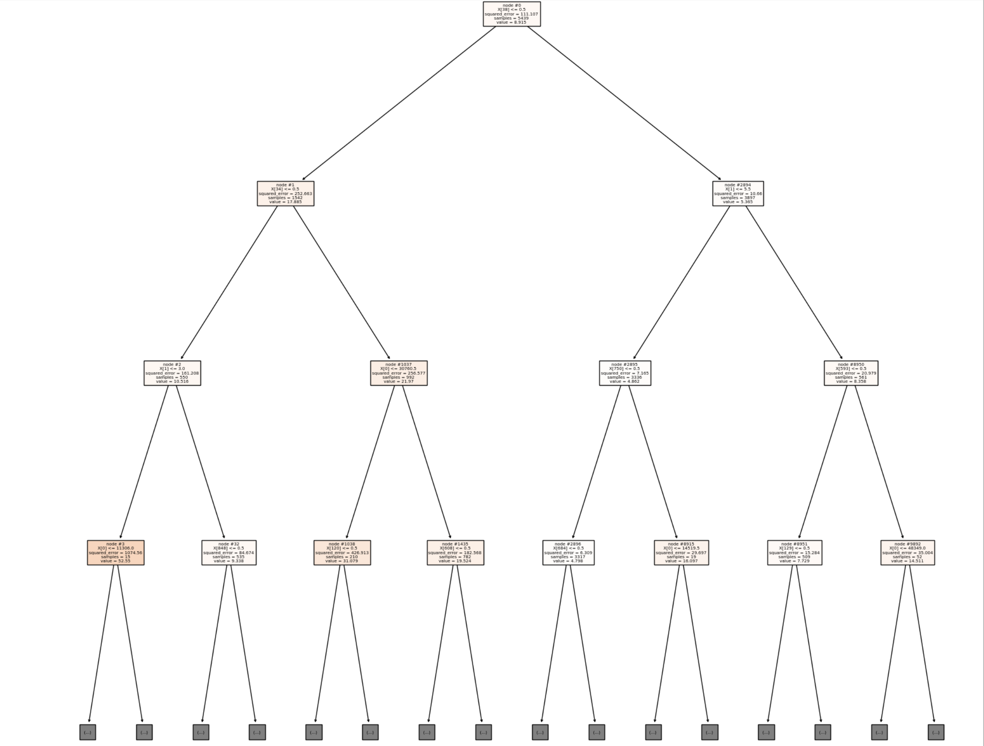
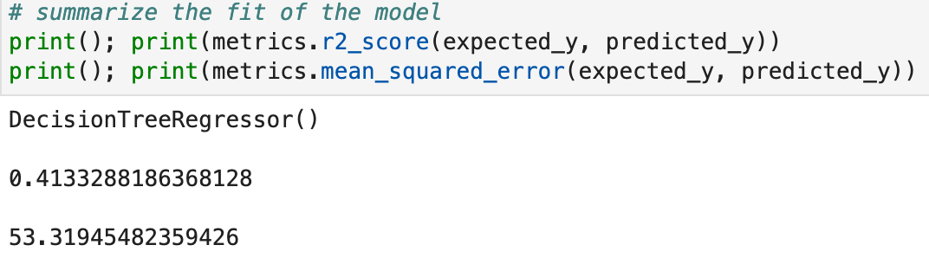
Decision Tree Regression Model

Slide 10
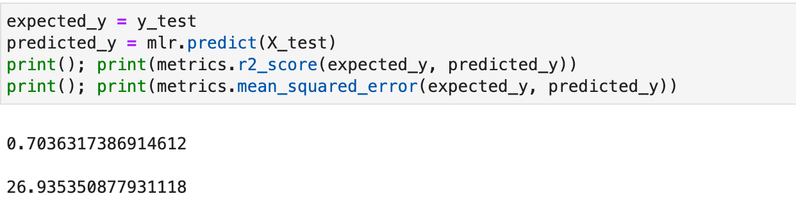
Multiple Linear Regression Model

Slide 11
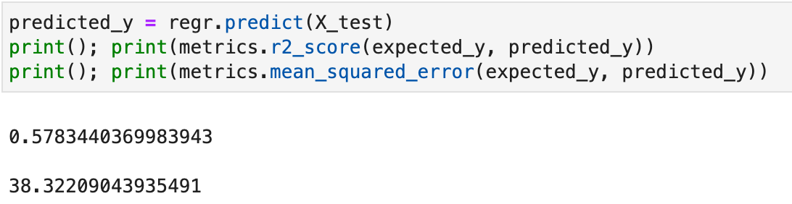
Random Forest Regression Model

Slide 12
Conclusion
,
Comparing three models, we get different three R^2 values, which are a. 0.4133288186368128, b. 0.7036317386914612, and c. 0.5783440369983943. Therefore, the multiple linear regression model has the largest r^2 value, which means it has the most accuracy.
From Multiple Linear Regressions, we get the intercept equals -3.7569203766223502 and varies intercepts with each variable.

Slide 13
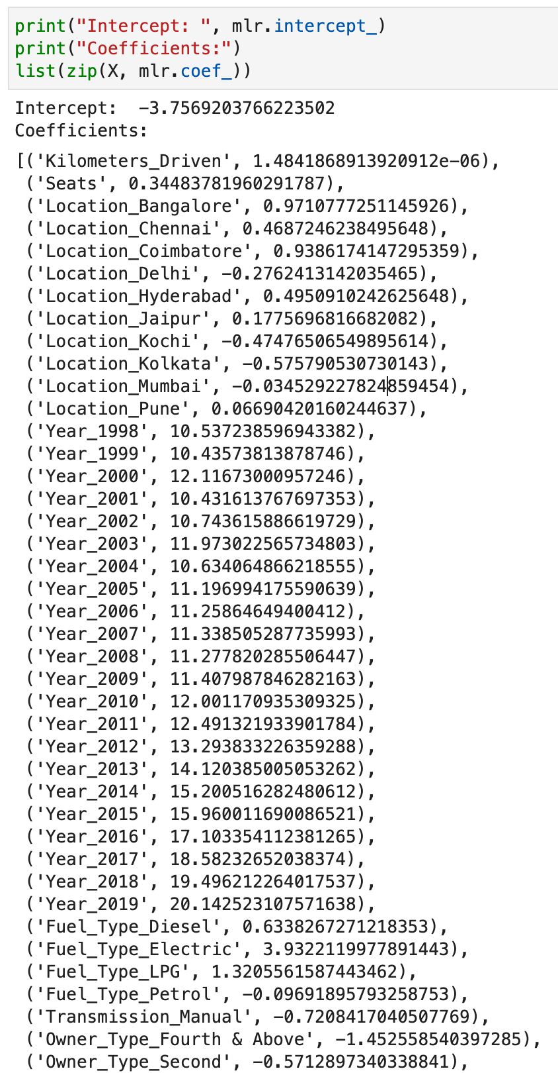
Conclusion
Prediction equation:
b_0: -3.7569203766223502
b_1,b_2,b_3….b_p:
Independent variable: Price(Y)
Dependent variable: 'Kilometers_Driven’, 'Seats’,
‘Location_x’, ‘Year_x’, ‘Fuel_Type_x’, 'Transmission_Manual’,
'Owner_Type_x’, 'Mileage_x’, 'Engine_x’, 'Power_x’, …

Slide 14

Thanks for Watching! Happy Christmas!

